Slide 1
Lecture 14: Extinction

Slide 2
Let’s Review…Basic Behavioral Contingencies
Operant conditioning = modification by consequences
 | Presentation of stimulus | Removal of stimulus
Increase probability of behavior | Positive Reinforcement | Negative Reinforcement
Decrease probability of behavior | Positive Punishment | Negative Punishment
Consequences of operant behavior

Slide 3
Extinction Definition
Reinforcement for a previously reinforced behavior is withheld and as a result the frequency of that behavior decreases in the future
Reinforcer is withheld
Break Behavior→ Consequence relationship
We are not removing something→ we are no longer presenting it
Notes:
This does not mean that the behavior stops
https://www.youtube.com/watch?v=MfKjg20KM0s&list=PLveg46XkRCLTcCdVkq9NfvwavgBwKJMX2

Slide 4
Diagram of Extinction
EO
Deprived of water for a long period of time and person has history of reinforcement for getting water when turning the “C” tap
S^{D}
Tap on faucet marked with blue dot or letter “C”
Response
Turn tap with blue dot or “C”
S^{R+}
Cold water withheld
Turning tap marked with blue dot or “C” occurs less often in the future
Let’s assume the tap is broken or the water has been turned off to the tap.

Slide 5
Definition of Extinction
Provides zero probability of reinforcement
The effectiveness is dependent primarily on the identification of reinforcing consequences and consistent application of the procedure
Extinction does not require the application of aversive stimuli to decrease behavior

Slide 6
Extinction Procedures
Extinction of Behavior Maintained by Positive Reinforcement
Behaviors maintained by positive reinforcement are placed on extinction when those behaviors do not produce the reinforcer
Extinction of Behavior Maintained by Negative Reinforcement
Behaviors maintained by negative reinforcement are place on extinction (escape extinction) when those behaviors do not produce a removal of the aversive stimulus
The individual cannot escape from the aversive situation

Slide 7
Extinction Procedures
Extinction of Behavior Maintained by Automatic Reinforcement
Behaviors maintained by automatic reinforcement are placed on extinction by masking or removing the sensory consequence (sensory extinction)
Not a recommended treatment option for problem behavior, even self-stimulatory behaviors that are maintained by social consequences or negative reinforcement

Slide 8
Extinction Effects
Gradual Decrease in Frequency and Amplitude
Extinction produces a gradual reduction in behavior
However, when reinforcement is removed abruptly, numerous unreinforced responses can follow
Often difficult for teachers and parents to apply because of the initial increase in frequency and magnitude and the gradual decrease in behavior

Slide 9
Extinction Effects
Extinction Burst
An immediate increase in the frequency of the response after the removal of the positive, negative, or automatic reinforcement
“An increase in responding during any of the first three treatment sessions above that observed during all of the last five baseline sessions or all of baseline” (Lerman, Iwata, & Wallace, 1999)

Slide 10
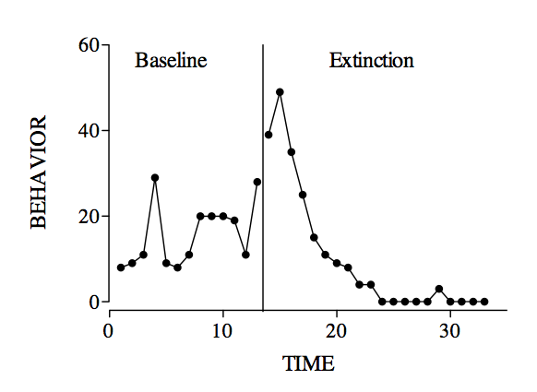
Extinction Burst
Spontaneous Recovery

Slide 11
Extinction Effects
Problem behaviors can worsen during extinction before they show improvement
Extinction bursts usually suggest that the reinforcer(s) maintaining the problem behavior was successfully identified, indicating that there is a good chance of an effective intervention

Slide 12
Extinction Effects
Spontaneous Recovery
The behavior that diminished during the extinction process recurs even though the behavior does not produce reinforcement
Short-lived and limited if the extinction procedure remains in effect

Slide 13
Variables Affecting Resistance to Extinction
Resistance to extinction
Continued responding during the extinction process.
Behavior that continues to occur during extinction is said to have better resistance to extinction than behavior that diminishes more quickly

Slide 14
Variables Affecting Resistance to Extinction
Three tentative statements describing resistance to extinction as it relates to continuous and intermittent reinforcement:
Intermittent reinforcement may produce behavior with greater resistance to extinction than the resistance produced by continuous reinforcement
Some intermittent schedules may produce more resistant than others
To a degree, the thinner the intermittent schedule of reinforcement is the greater the resistance to extinction will be

Slide 15
Variables Affecting Resistance to Extinction
Establishing Operations
All stimuli that function as reinforcers require a minimum level of an establishing operation (i.e., motivation must be present)
Number, Magnitude, and Quality of Reinforcement
The number of times a behavior produces reinforcement may influence resistance to extinction
A behavior with a long history of reinforcement may have more resistance to extinction than a behavior with a shorter history of reinforcement

Slide 16
Variables Affecting Resistance to Extinction
Number of Previous Extinction Trials
Successive applications of conditioning and extinction may influence the resistance to extinction
Response Effort
The effort required for a response apparently influences its resistance to extinction
A response requiring great effort diminishes more quickly during extinction than a response requiring less effort

Slide 17
10 Guidelines for Application of Extinction
Withholding all reinforcers maintaining the problem behavior
Withholding reinforcement consistently
Combining extinction with other procedures
Using instructions
Planning for extinction-produced aggression
Increasing the number of extinction trials
Including significant others in extinction
Guarding against unintentional extinction
Maintaining extinction-decreased behavior
When not to use extinction

Slide 18
Using Extinction Effectively
Withholding all reinforcers maintaining the problem behavior
Identify & withhold all possible sources of reinforcement that maintain the target behavior
Withholding Reinforcement Consistently
All behavior change procedures require consistent application, but consistency is essential for extinction

Slide 19
Using Extinction Effectively
Combining Extinction with Other Procedures
Differential reinforcement and antecedent procedures hold promise for reducing extinction effects such as bursting and aggression
Using Instructions
Behaviors sometime diminish more quickly during extinction when teachers describe the extinction procedure to students

Slide 20
Using Extinction Effectively
Planning for Extinction-Produced Aggression
Behaviors that occurred infrequently in the past will sometimes become prominent during extinction by replacing the problem behaviors. Frequently, these side effect replacement behaviors are aggressive (Lerman et al., 1999)
Increasing the Number of Extinction Trials
An extinction trial occurs each time the behavior does not produce reinforcement

Slide 21
Using Extinction Effectively
Including Significant Others in Extinction
All individuals in contact with the learner must apply the same extinction procedure for effective treatment
Guarding against Unintentional Extinction
Desirable behaviors are often unintentionally placed on extinction

Slide 22
Using Extinction Effectively
Maintaining Extinction-Decreased Behavior
Applied behavior analysts leave the extinction procedure in effect permanently for maintaining the extinction-diminished behavior

Slide 23
When not to use extinction
Imitation
Extinction can be inappropriate if the behavior placed on extinction are likely to be imitated by others
Extreme Behaviors
Some behaviors are so harmful to self or others or so destructive to property that they must be controlled with the most rapid and humane procedure available
Extinction as a singular intervention is not recommended in such situations

